Slide 1

EDA – Summer Olympics
Prepared By : Harjeet Kaur

Slide 2
Summer Olympics - EDA
This EDA represents the Data analysis for Summer Olympics history back from 1896 till 2012.
Olympics Hosting
Countries Participation over the Olympics History.
Olympics hosted Cities
Medals :
Top 5 Countries in Olympics History
Trend in medal won count over the years.
Top 3 Countries over the history
Sports and Discipline added over the Years.
Men and Women Performance over the years
India Performance in Olympics History
Top 10 - Men and Women Athlete

Slide 3
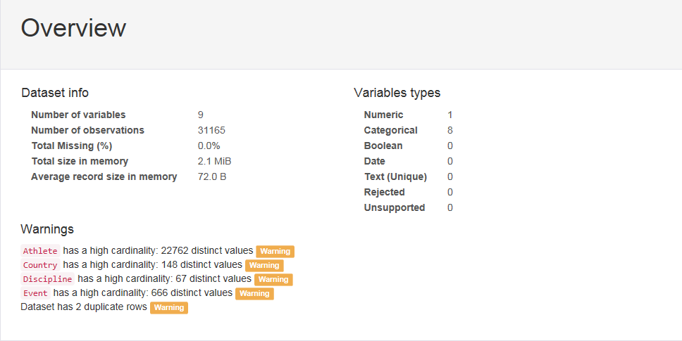
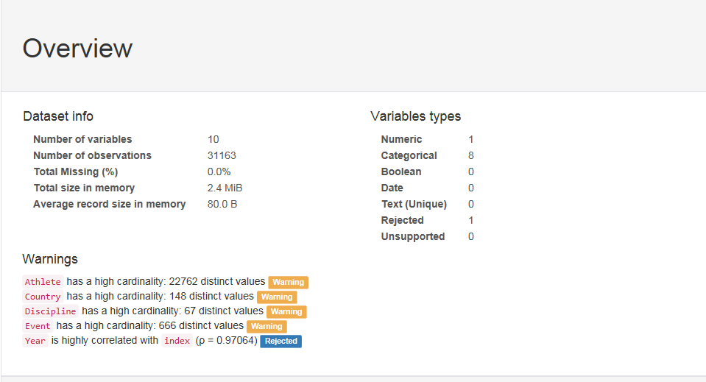
Data Pre-processing

Slide 4
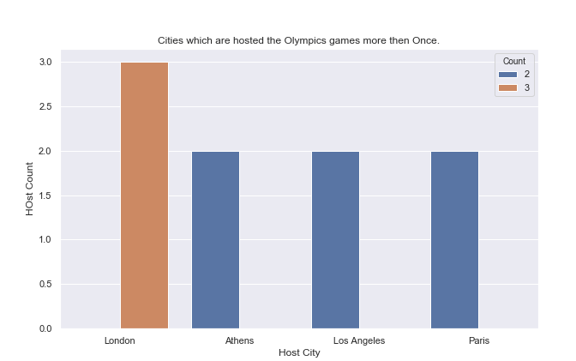
Olympics Hosting City
Four cities had hosted the Olympics games more than ONCE, but London has hosted the Olympics games 3 times.

Slide 5
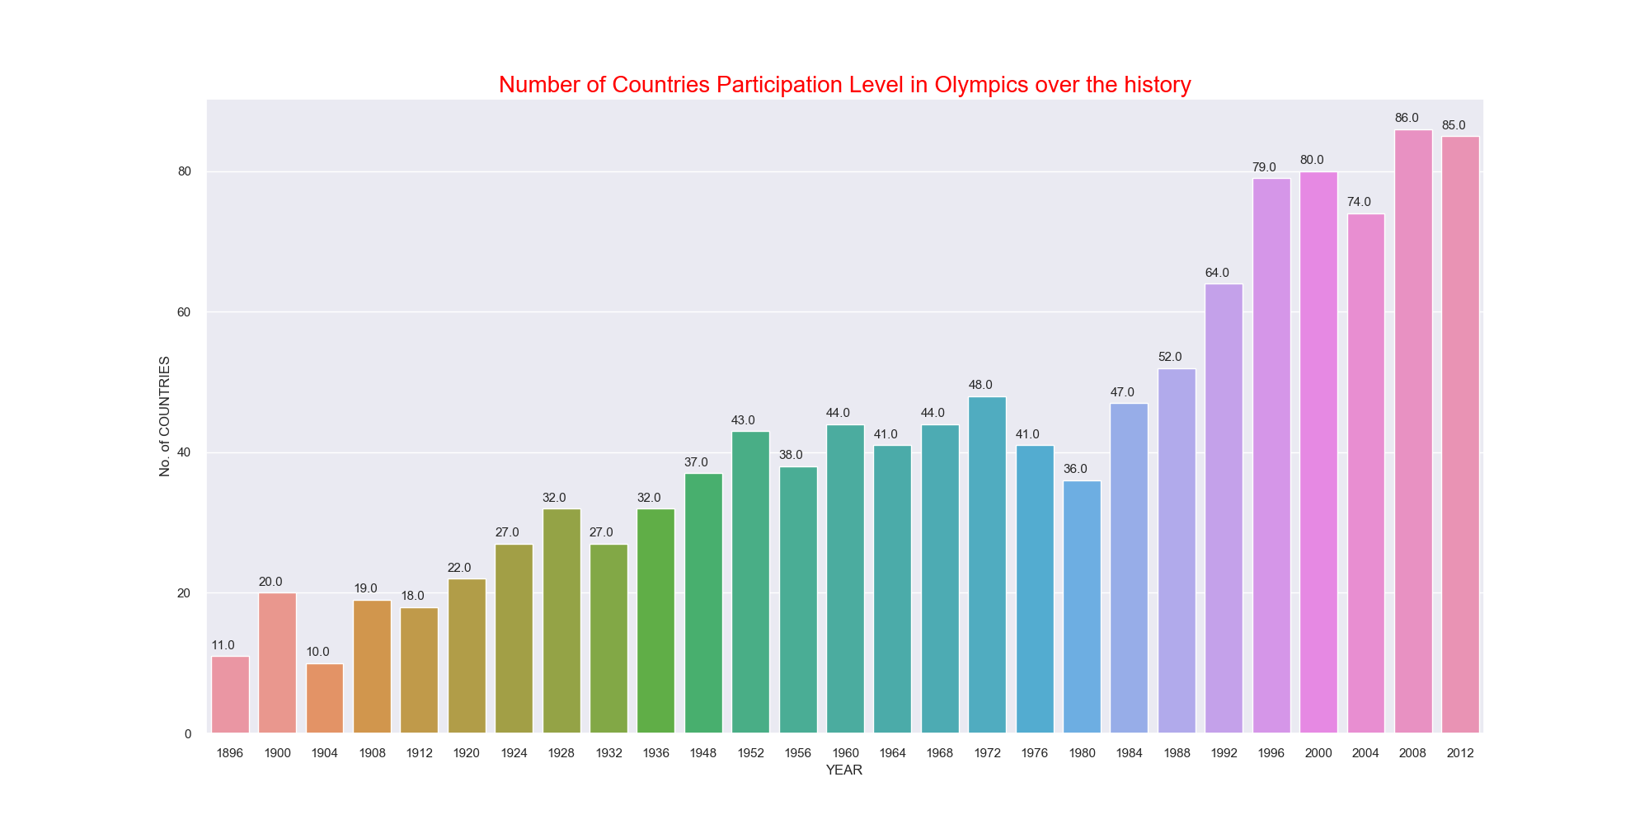
Countries Participation Level in Olympics History

Slide 6
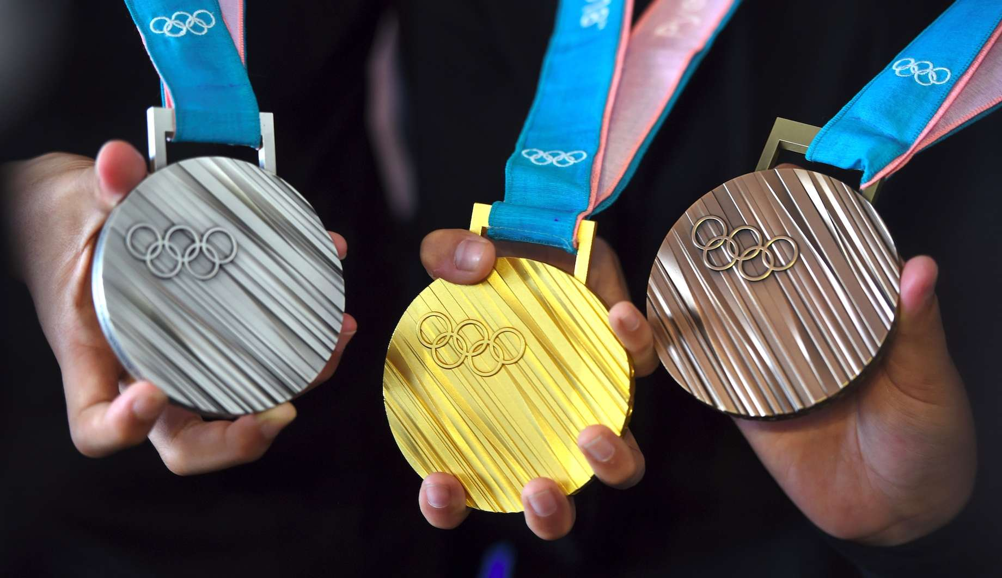

Slide 7
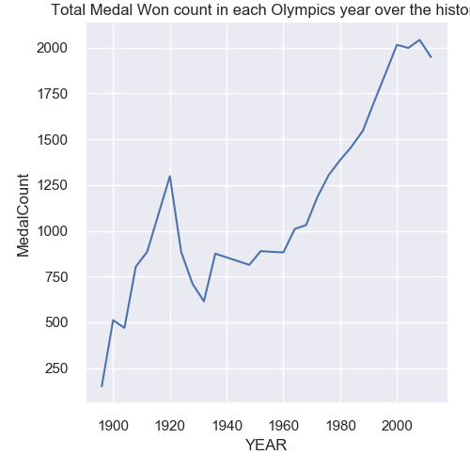
Total Medal Won Count in Olympic History
Overall Positive trend in number of medal won count in each Olympics over the history.
There is steep rise in Medal won in 1920 as 1250 medals and few dips in next 20 years but picking up upward pace from 1960 Olympics onwards.

Slide 8
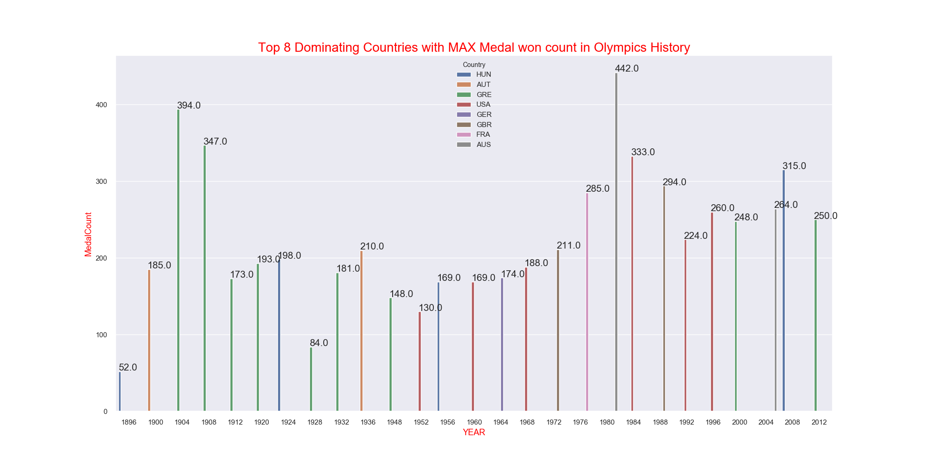

Slide 9
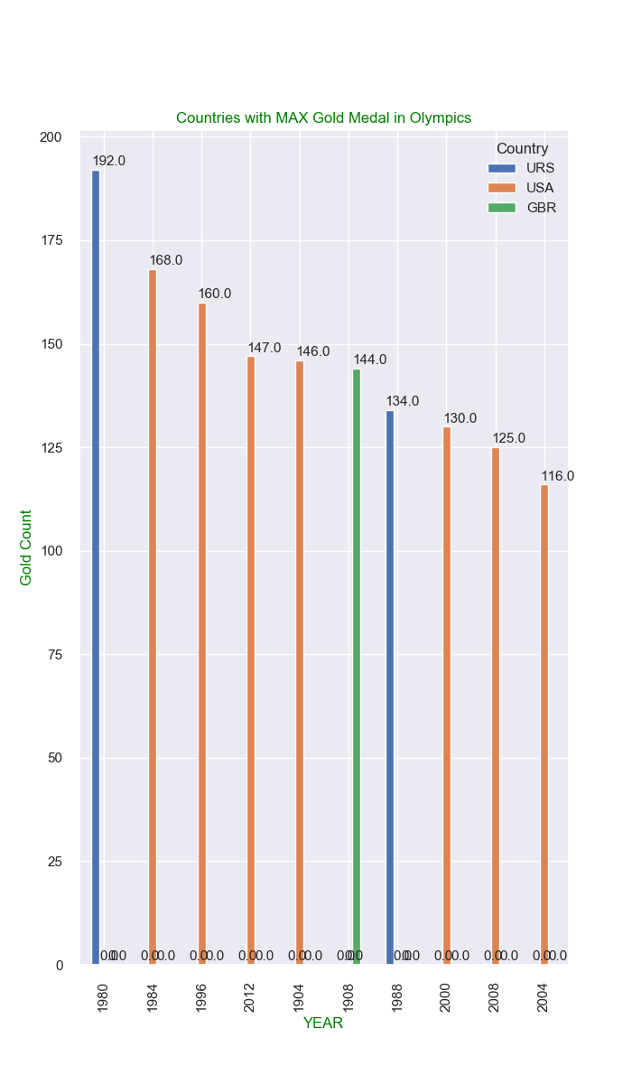
Top 10 Countries with MAX Gold Medals in Olympics. URS, USA and Great Britain are dominating in Gold Medal Count

Slide 10
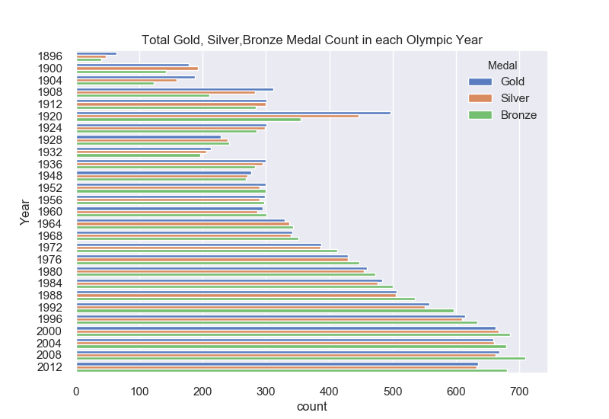
Total number of Gold Silver,Bronze medal won over the Olympic history:-
Around 500 Gold medal won in 1920
From 1976 , more than 400 medals has won each year.
Medal crossed 700 mark in year 2008
Highly positive trend.

Slide 11
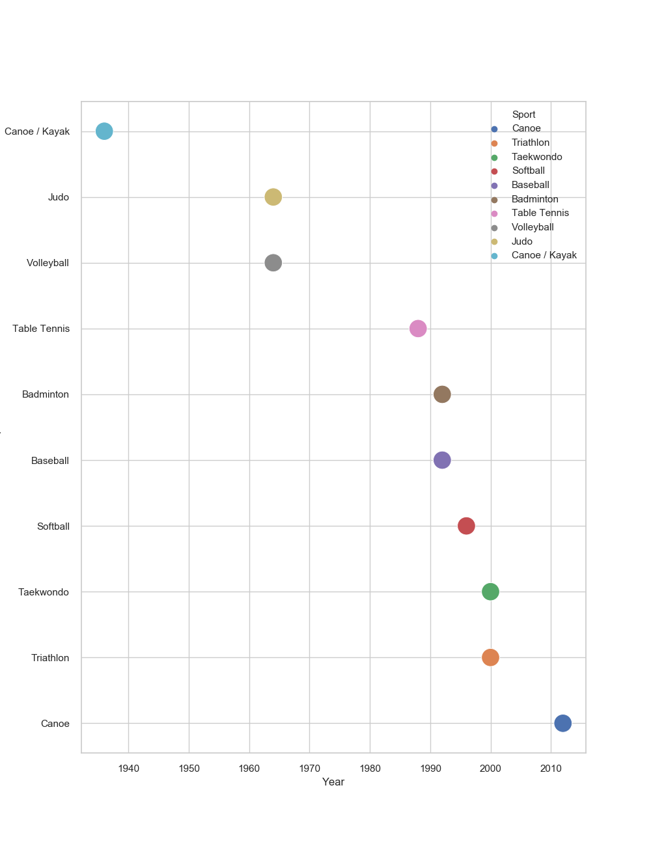
Sports AND Discipline added over the years Canoe and Triathlon has recently added in Olympics

Slide 12
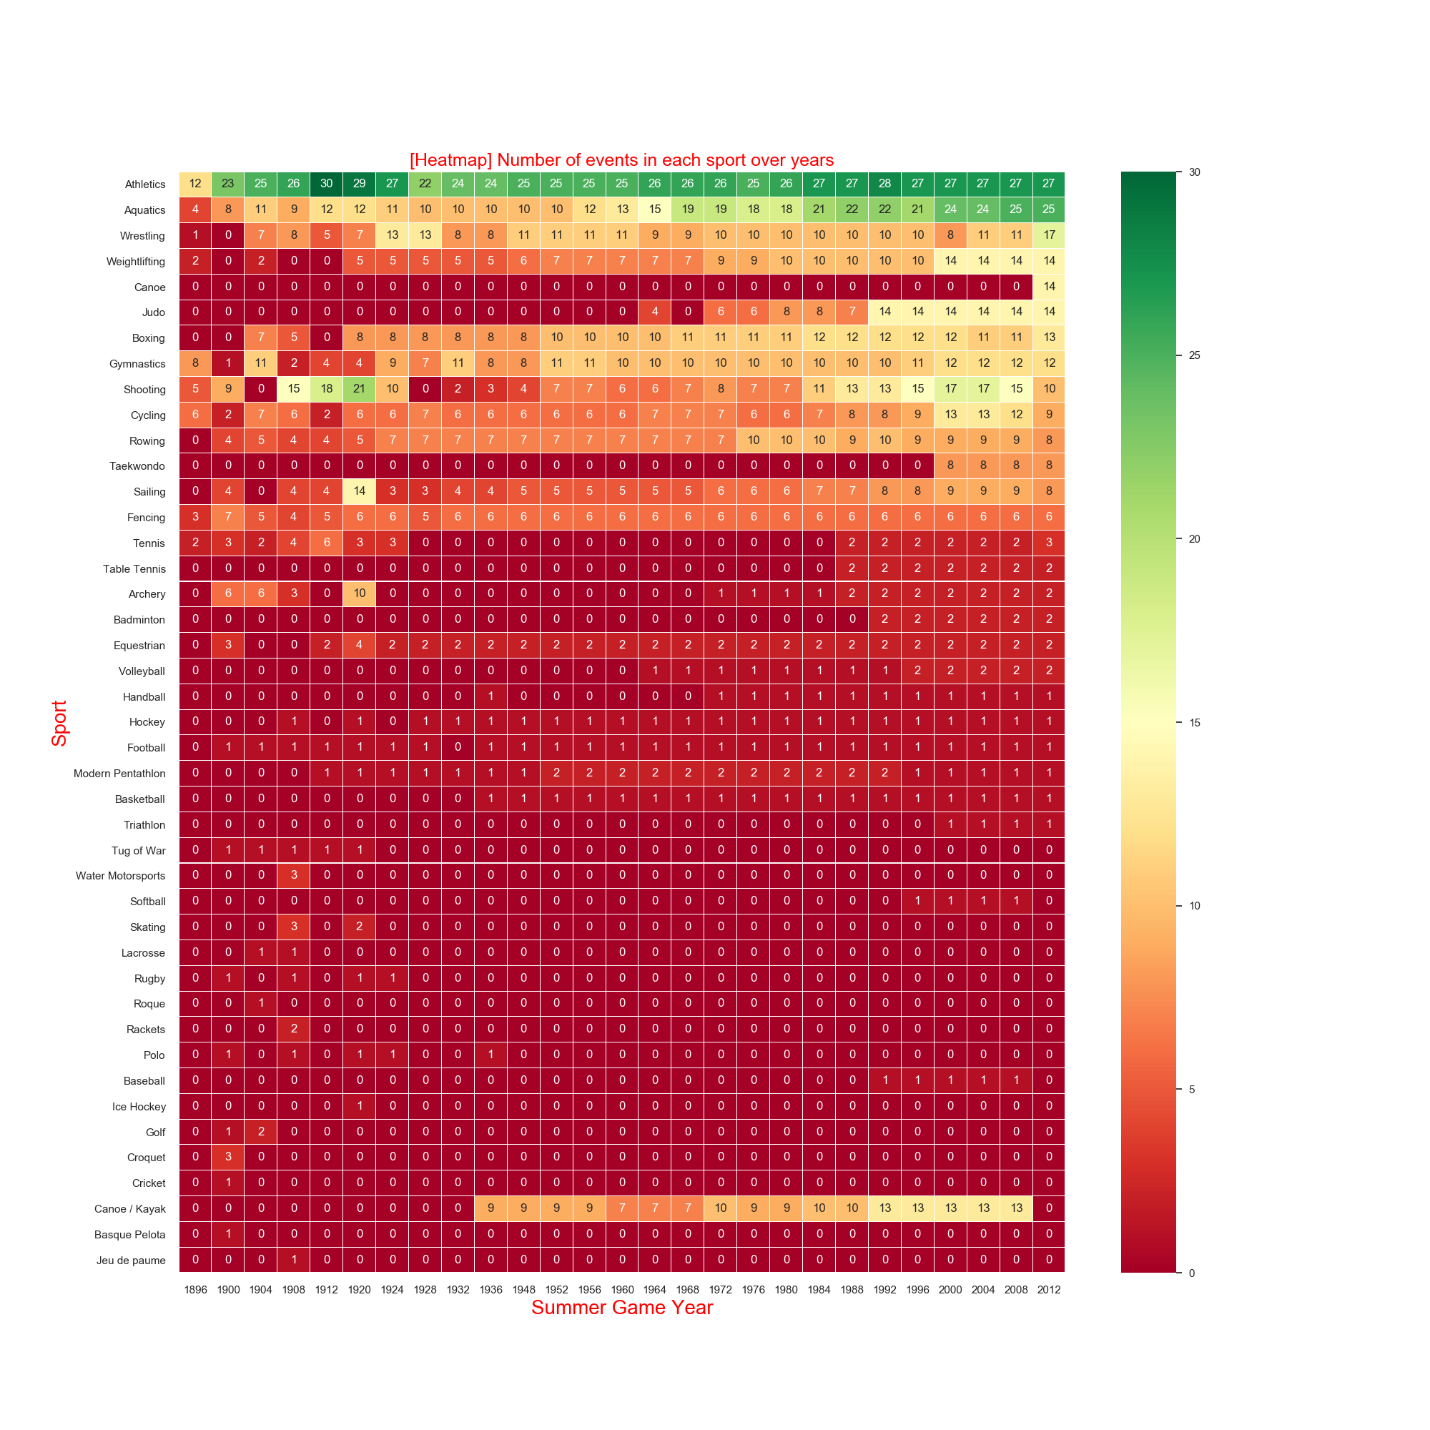
Number of Events per Sport in each Year
Athletics and Aquatic host maximum number of events.

Slide 13
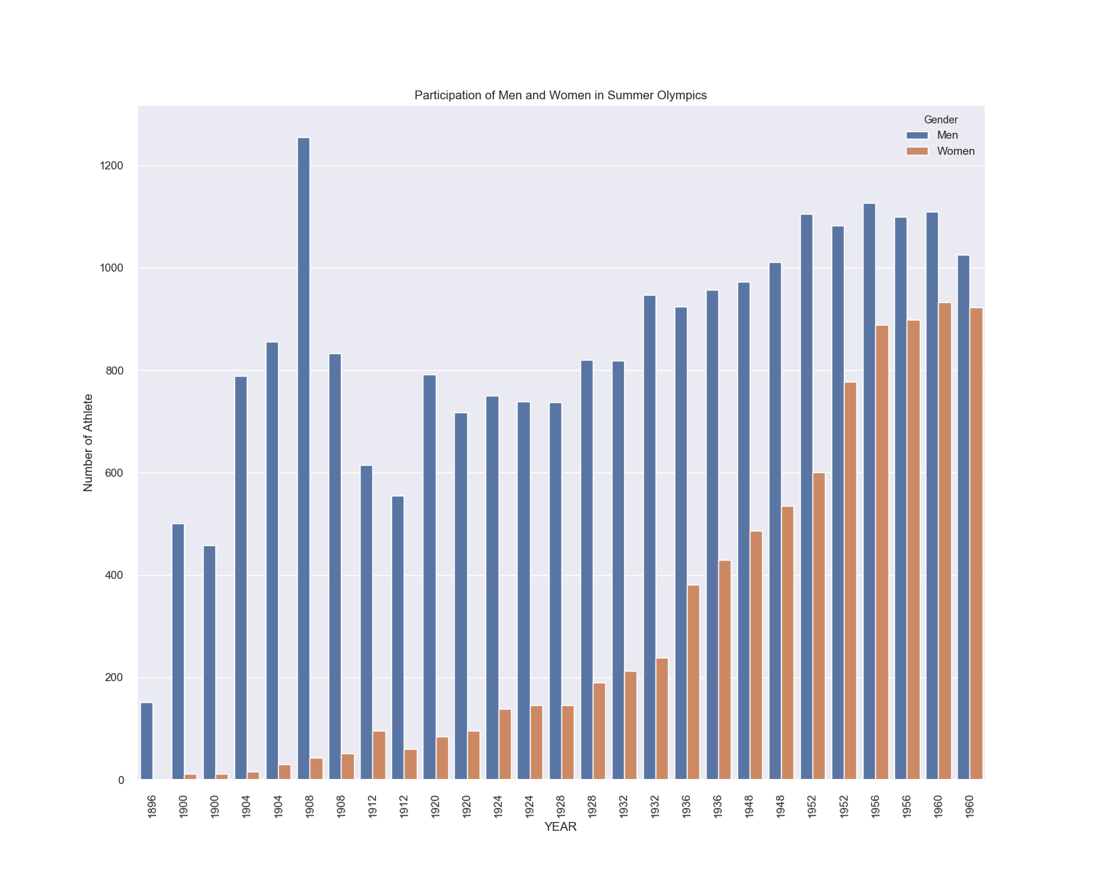
1.Men Athlete are dominating in participation. 2. Women participation increasing over time and may surpass the men in near future.

Slide 14
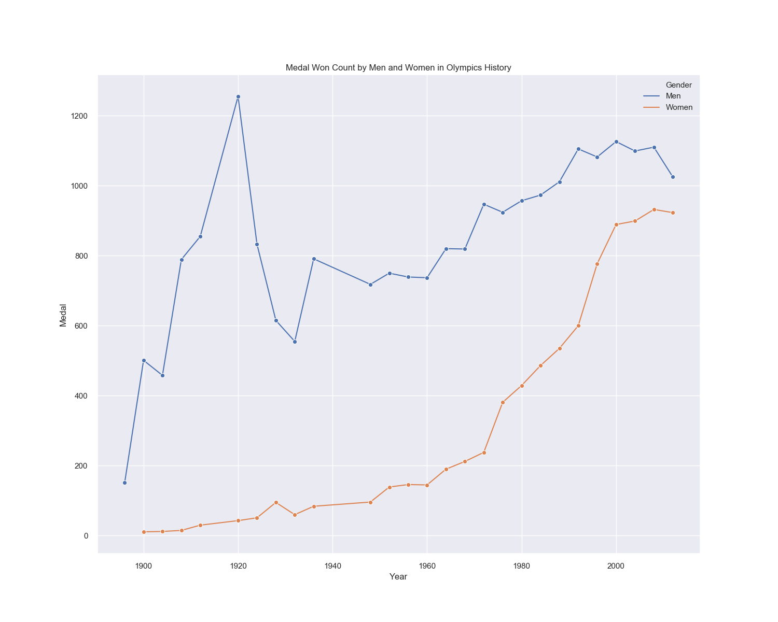
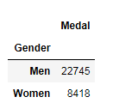
1. Women Athlete Started performing from the year 1900 onwards. 2. There are highly uprising trend in their performance over the years. 3. Men Athlete are dominating in bagging the Olympics Medals, but Women Athlete performance almost converges to men towards year 2000.
Performance of Men and Women Athlete in Olympics History

Slide 15
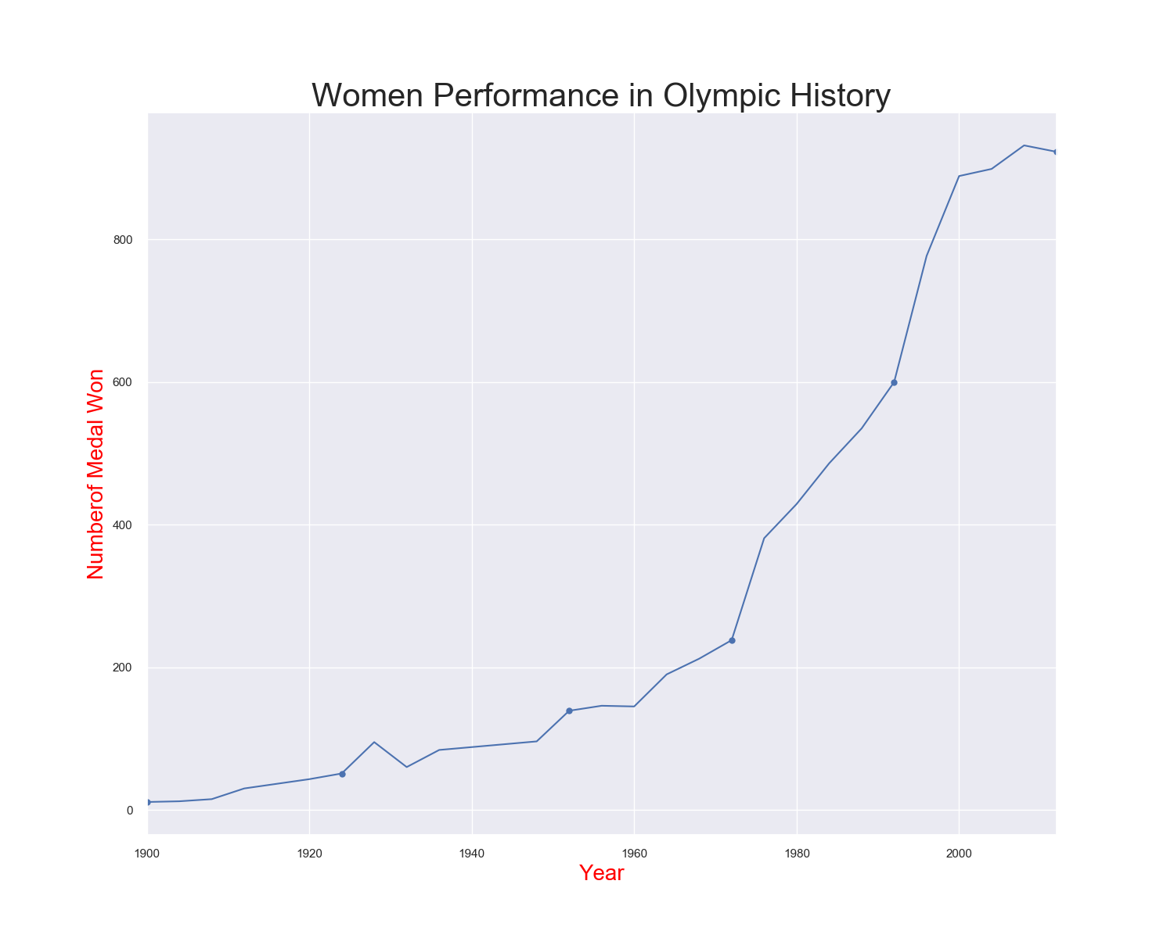
Women Performance in Olympics significantly increase in the history. There were highly positive trend. Women performance increase 800% .

Slide 16

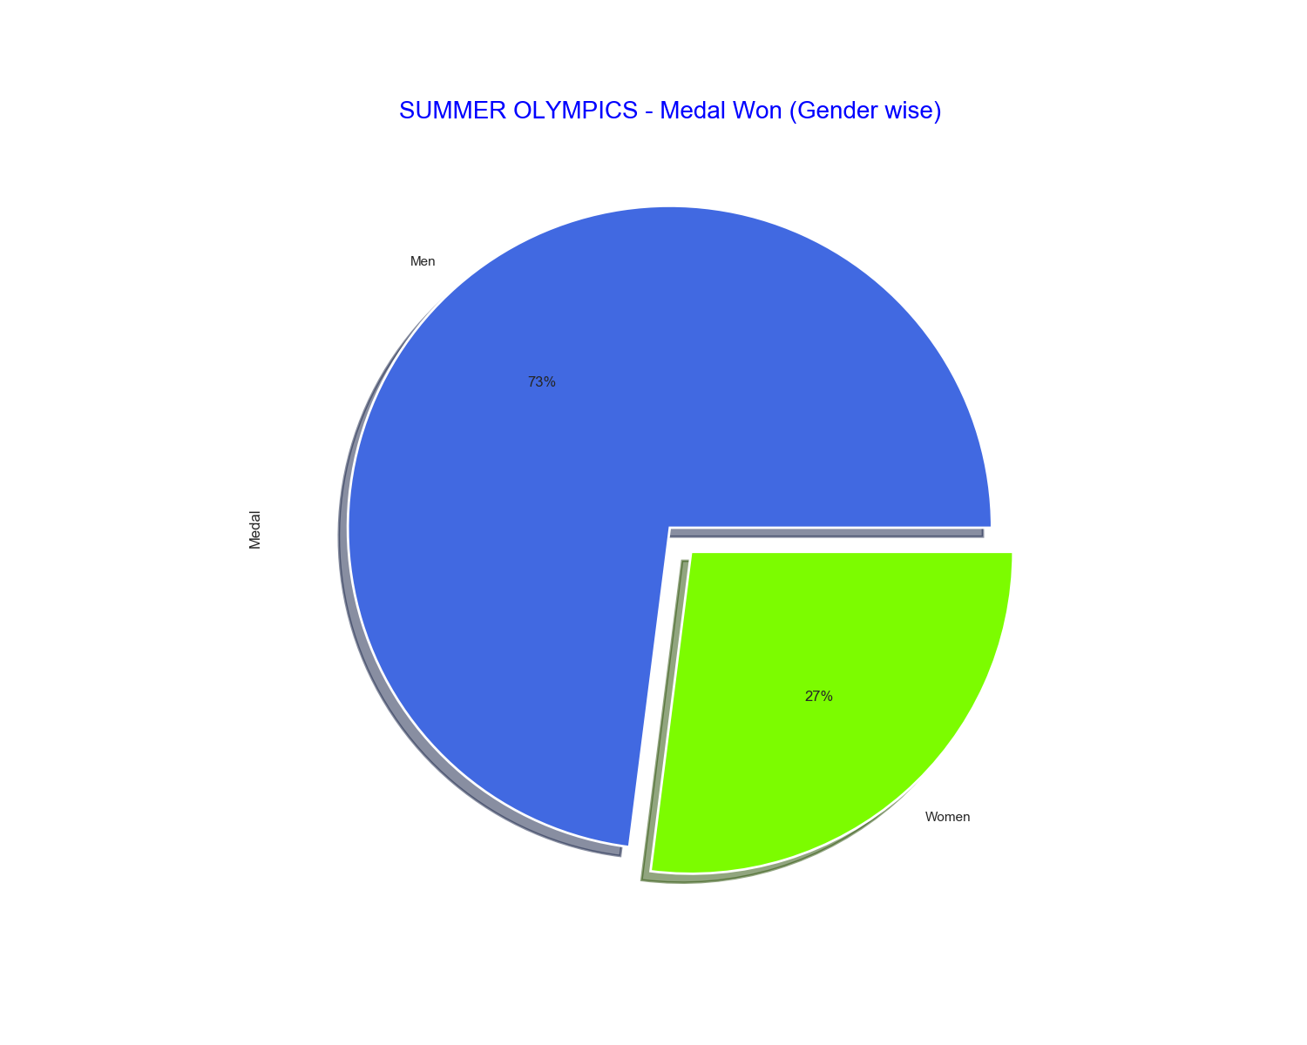
Medal Won by Men and Women in Olympics in Percentage
73% of the total medal won count in Olympics were Men and women contributed to 27%.
Men were dominating in medal count, but women also started contributed close to 1/3rd of total medal won count after year 1900.

Slide 17
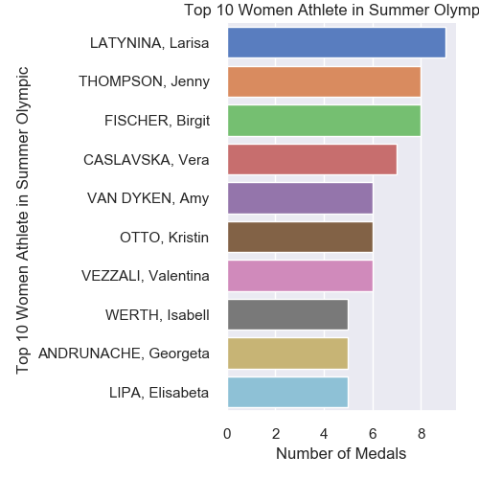
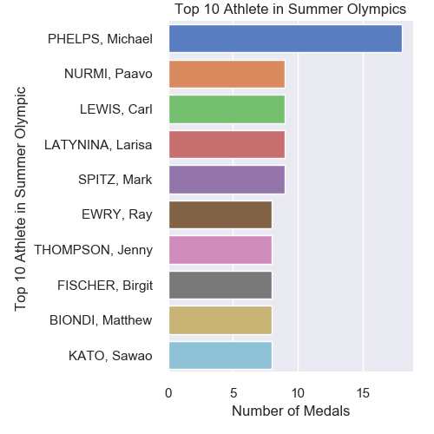
Top 10 Athlete in Olympics history

Slide 18
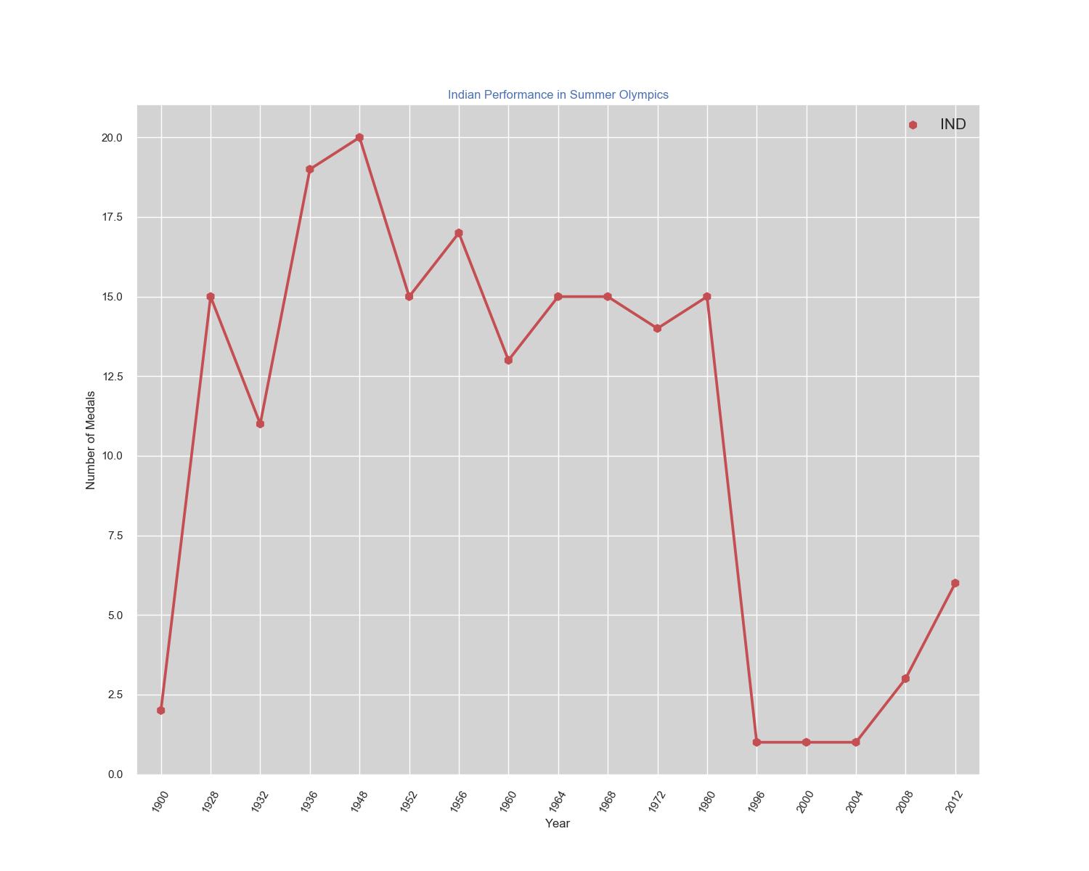
Indian Performance in Summer Olympics
India has performed quite well in early Olympics.
India bagged maximum 20 Olympics medal in the year 1948 which is the year when India got Independence.
This shows that the sentiments and victory plays important role in Athlete moral level.
After 1948, India’s performance decreased over time.
India has not won any Medal between 1980 to 1996 in FOUR Olympics games.
There is again positive trend shown after 1996.

Slide 19
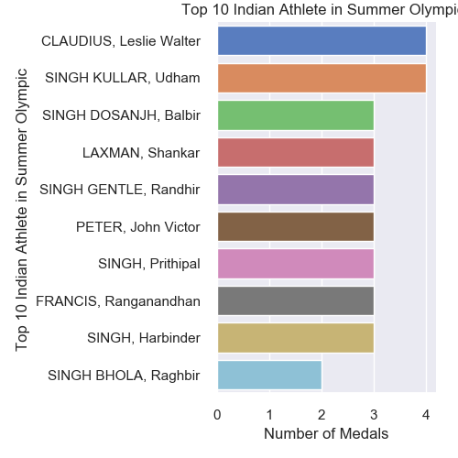
Top Ten Indian Athlete in Olympics Games
Leslie Walter Claudius was the FIRST Athlete to bag a Olympic Medal for India.
Udham Singh Kullar and Balbir Singh Dosanjh were the top Indian Athlete.
2 Athletes has bagged 4 medals whereas 7 bagged 3 Olympic medals each.

Slide 20
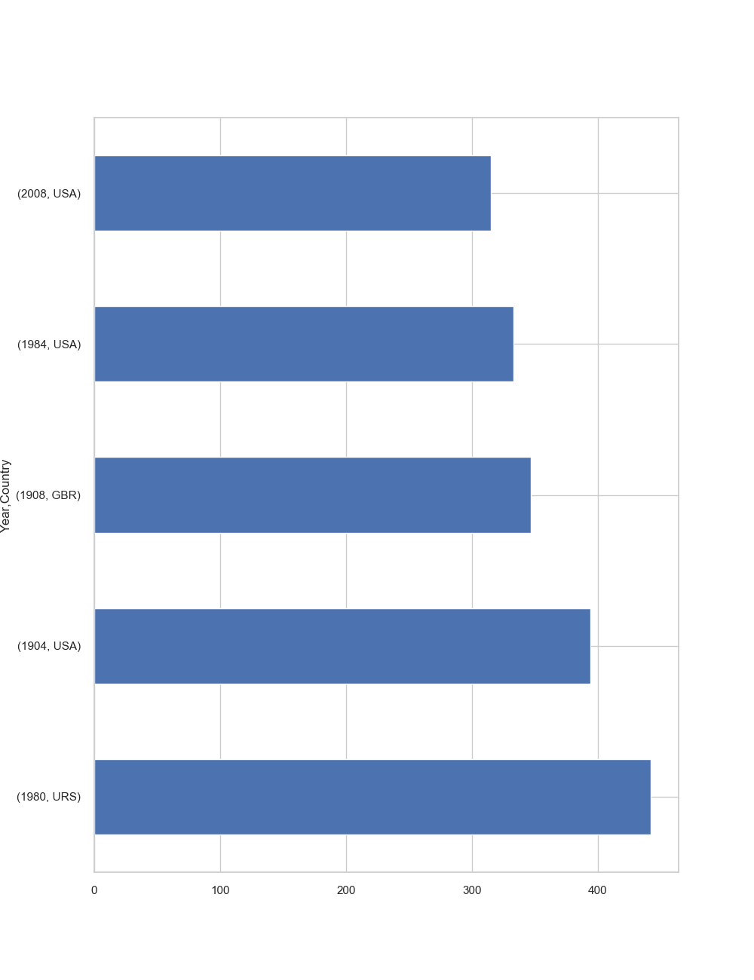
Countries – Won Olympics games more than once.
URS, USA, GBR remain the countries which won the Olympics games more than once.
The countries has total won count more than 325.

Slide 21
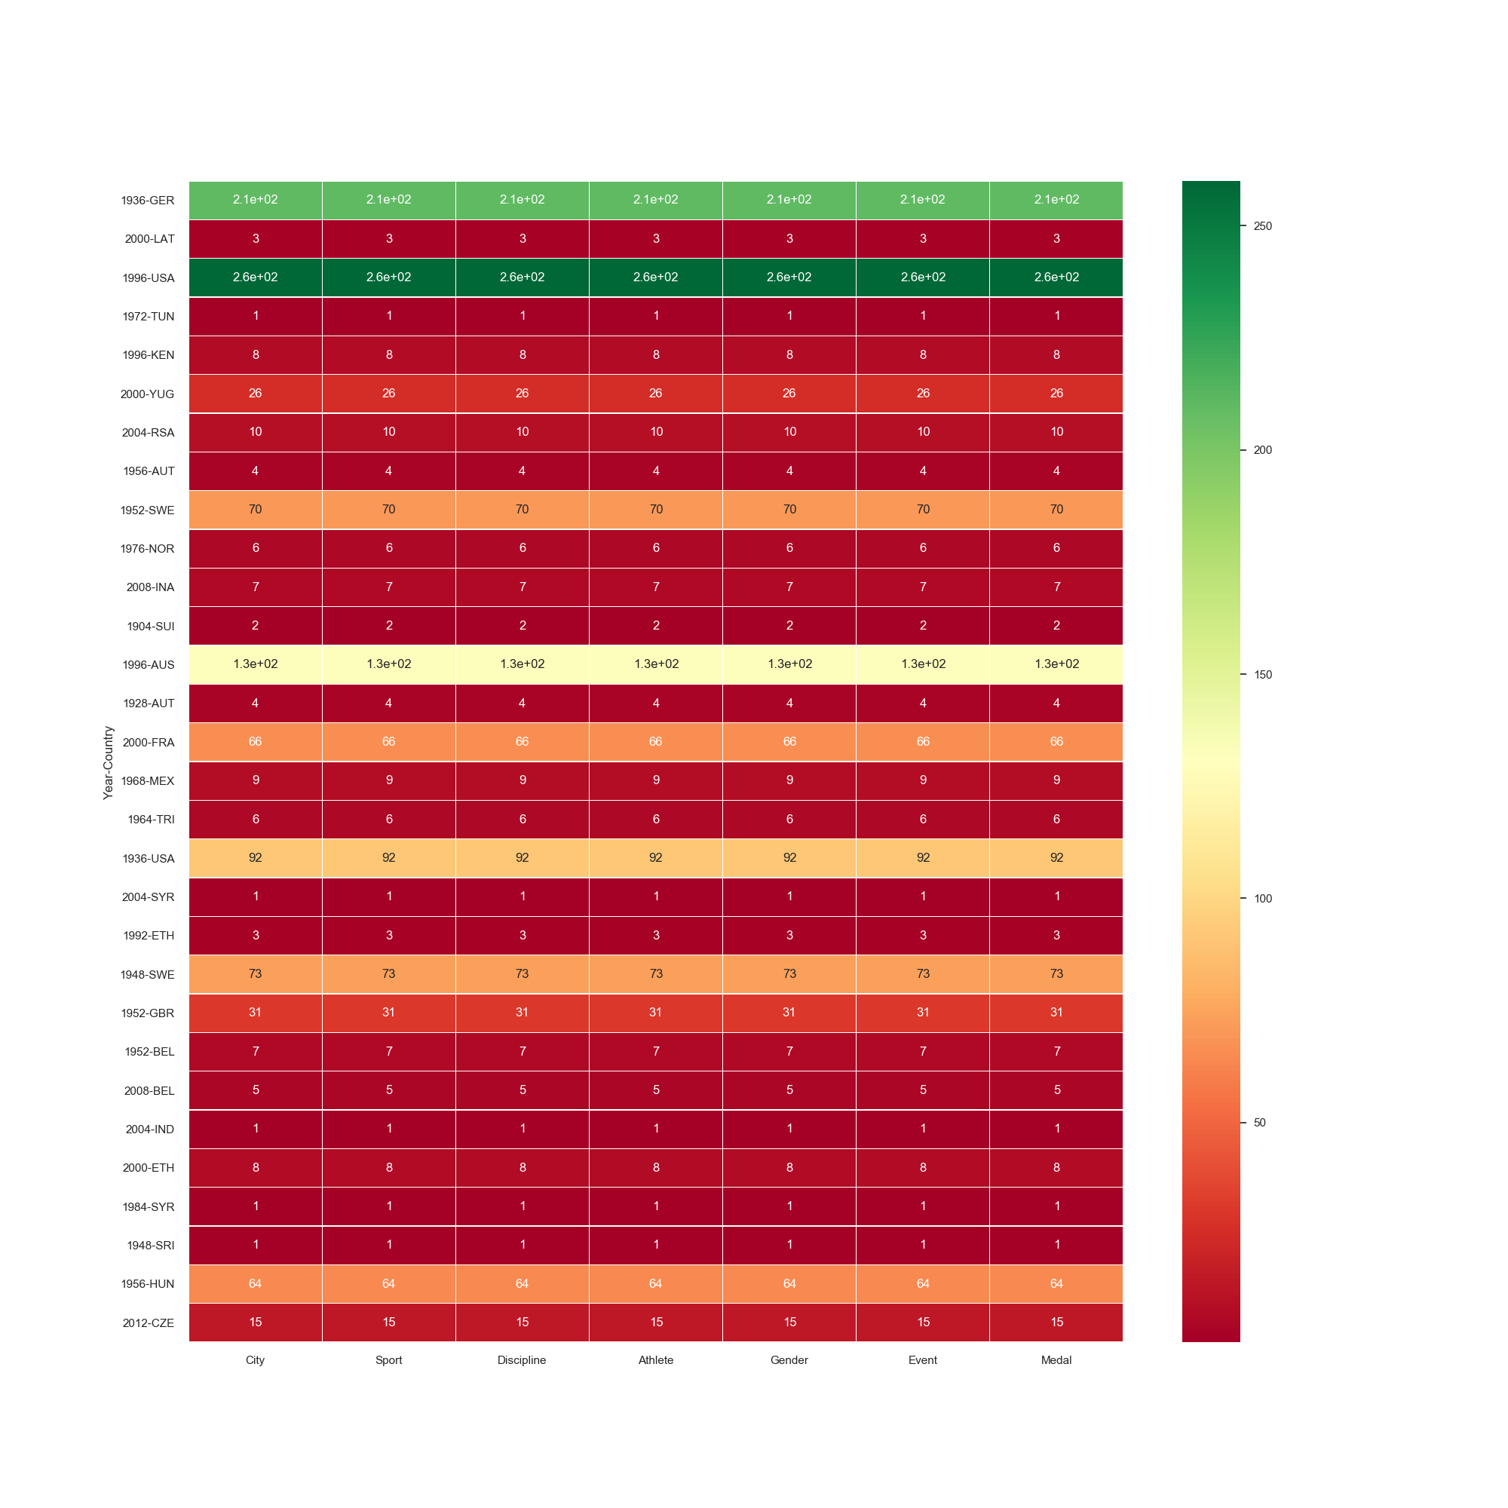
USA (1924),GER has high positive co-relation and won maximum medals in different Discipline and events in Olympics in different games. GBR,AUS has some co-relation exists in winning medals in Olympics. Whereas JAM,ETH,SRI,IRL among the countries with negative correlation and hardly able to won any Olympic medals.

Slide 22
Conclusion
The Olympics games being held for 27 times since 1896 and 22 different cities around the world hosted the games.
London hosted the games maximum of 3 times , whereas Paris,Athens,Los Angeles hosted more than once.
The participation level also increase dramitically in Olympics from 1896 onwards. It was 10 countries participated in FIRST Olympics games which rises to 86 Nations world wide by the year 2012. There is higly upwards trends and Olympics again Popularity in few years from start.
The Medal won count increases over the period and from 1964, more than 1000 medals won by athletes in different events which rises close to 2000 medals.
Australia,Great Britain,USA were dominating countries in MAX medal won count.
URS,USA,GBR are the Countries with Maximum Number of Gold Medals in History
From 1988 onwards, on an average 500 medals being won by different countries.
Canoe,Trithalon,Teakwondo,Softball_ are the Newest games added to Olympics.
Athletics,Aquatics were the Sports with maximum events.
Men were dominating in bagging Olympics medals but women Athlete also pick up the pace with time. 73% Men 27% Women
Women Athlete Performance increased significantly over the period.
LATYINA Laisa, Thompson Jenny,FISCHER Birgit are the TOP THREE women Athlete.
Michael PHELPS , Paavo NURMI,Carl LEWIS are the TOP THREE Men Athletes.
Indian Olympics Performance was good from 1928 to 1956 with on average 15 Medals per Olympics
Indian Performance dropped from 1980 to 1996 with ZERO medal and gain momentum from 1996 onwards
Leslie Walter Claudius was the first Indian to bag MEDAL in Olympics followed by UDHAM Singh Kullar,Balbir Singh Dosanjh

Slide 23

Thank You
GitHub References
https://github.com/harjeet31/Summer-Olympics-EDA/blob/master/Olympic_Project_Term1%262.ipynb
https://github.com/harjeet31/Summer-Olympics-EDA/blob/master/Summer%20Olympics%20-%20EDA.pdf
https://github.com/harjeet31/Summer-Olympics-EDA/blob/master/OlympicsDataset_After_preprocessing.html

